Slide 1








E-Commerce Website
Wardrobe X
Guide By : Manish Dodia
Name : Yash Patel
M. Sc. [ Computer Application ]
Roll No. : 14

Slide 2



Project Profile
Goal & Objective:
Wardrobe X is designed to deliver a seamless online clothing shopping experience with secure authentication, product browsing, and order management.
Scope of the project:
The project covers complete e-commerce functionality including users, products, cart, orders, and admin/vendor dashboards.

Slide 3



System Environment
Hardware Environment
Computer/Laptop with minimum 4GB RAM
Internet connectivity required
Modern web browser (Chrome, Edge, etc.)
Software Requirement
Frontend: React.js
Backend: Node.js with Express.js
Database: MongoDB
Authentication: JWT (JSON Web Token)
PWA Support: Service Workers & IndexedDB
Payment Integration: Razorpay / Stripe APIs

Slide 4


Client Module
Register and login securely
Browse, search, filter, and sort products
View product details and recommendations
Add products to cart and manage cart
Place orders and make payments
Track order status
Request return or exchange
View and update profile
Admin Module
Manage users (view, update, delete)
Add, update, and delete products
Manage categories
View and manage all orders
Approve/reject return requests
Monitor sales analytics and reports
Detect and manage fraudulent activities
Vendor Module
Register and manage vendor profile
Add, update, and delete products
Manage product inventory (stock)
View and process orders
Handle exchange requests
Track sales and performance

Slide 5


Data Flow Diagram

Slide 6

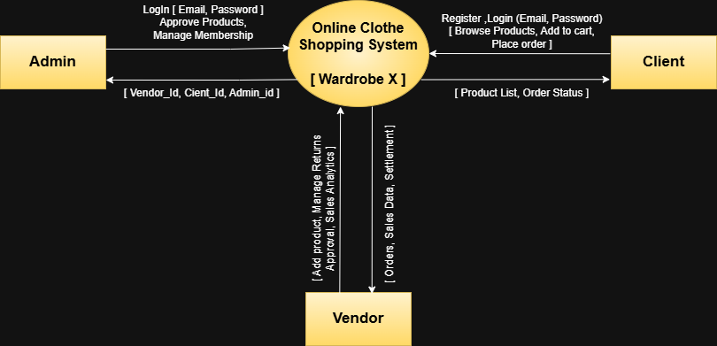

0 Level Dfd:

Slide 7
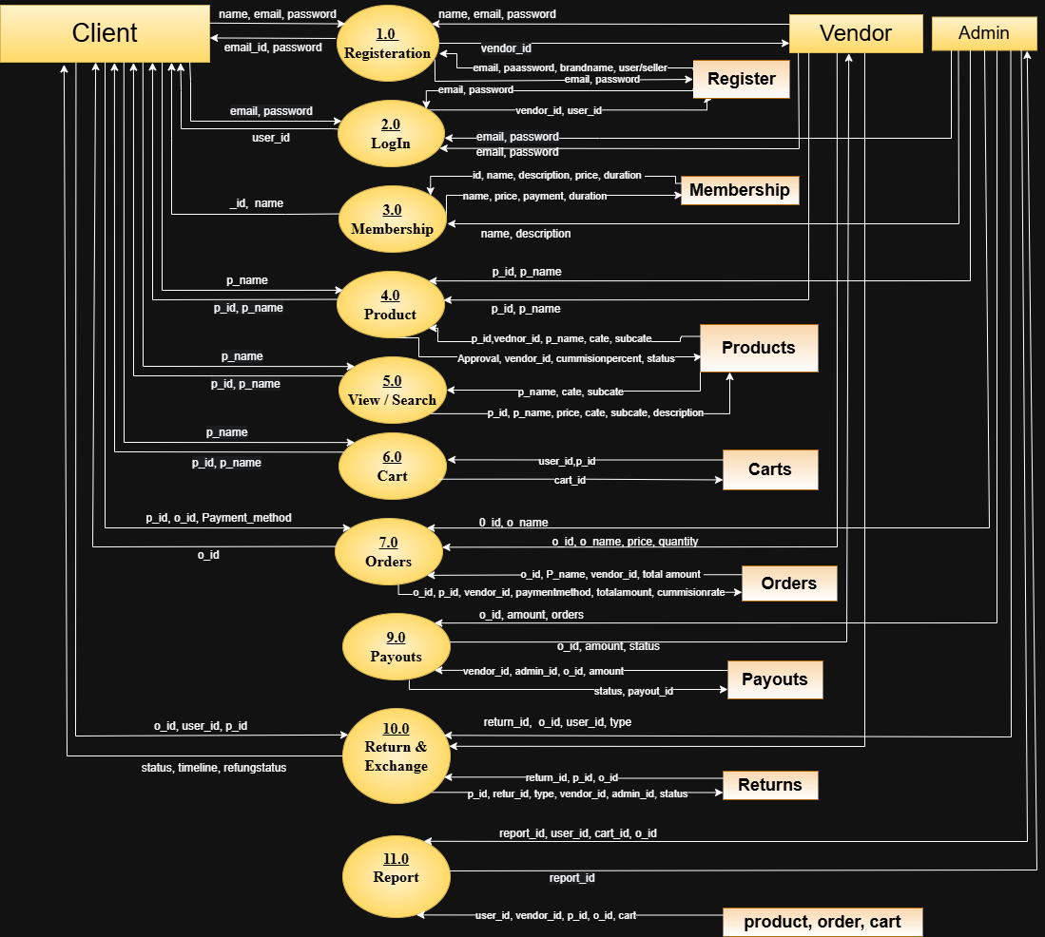
1st Level Dfd:

Slide 8
Data Dictionary

Slide 9
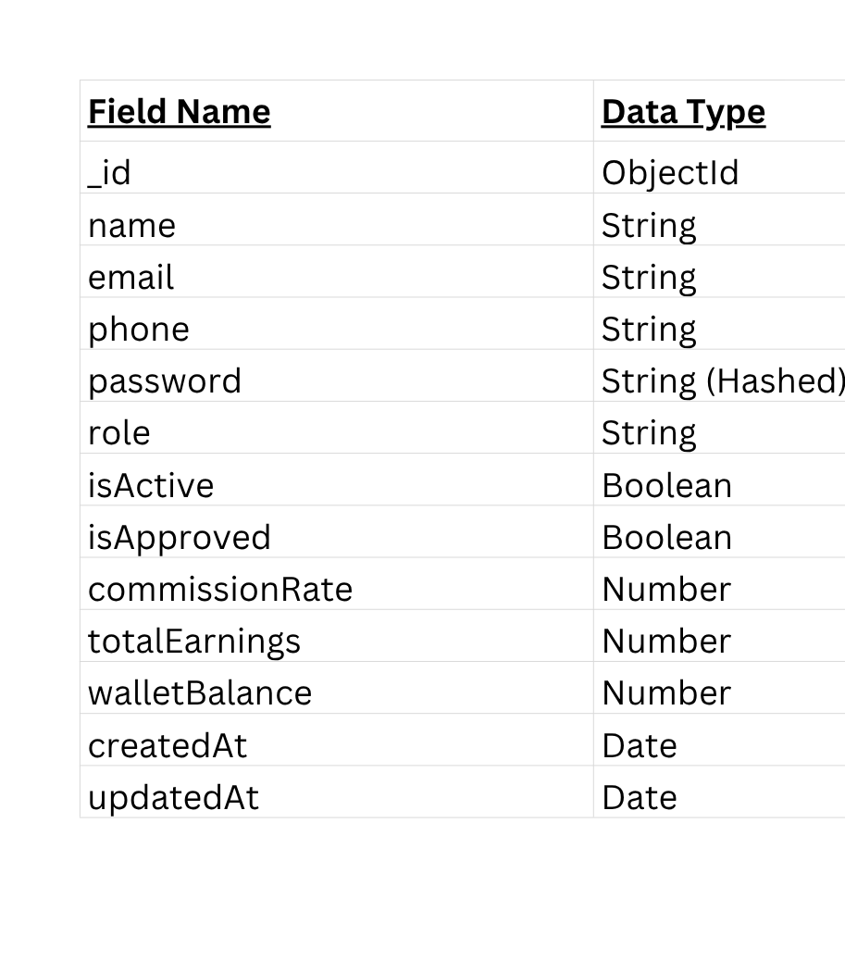
User

Slide 10
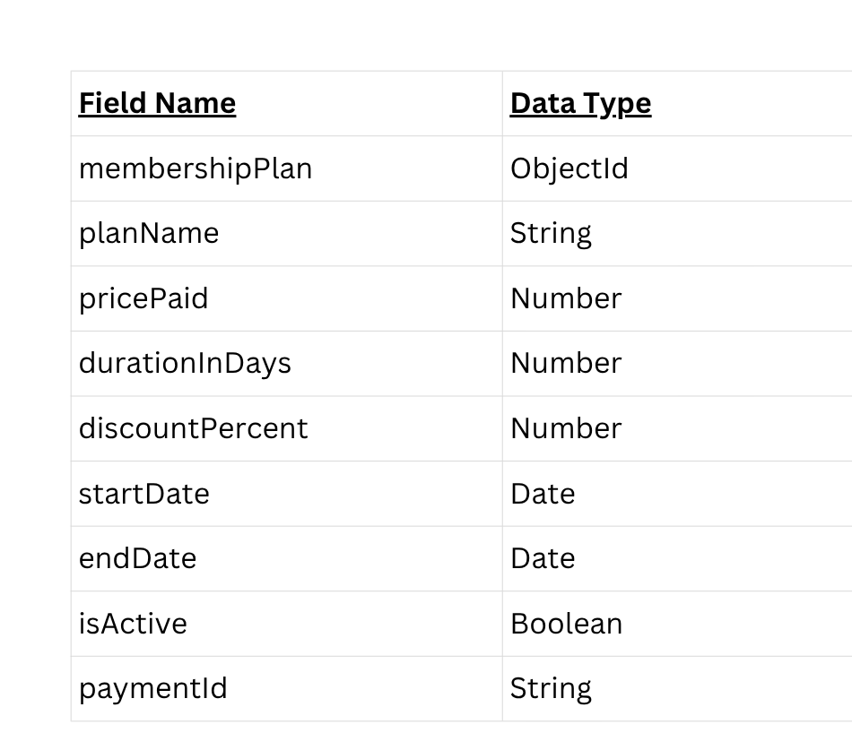
Membership

Slide 11
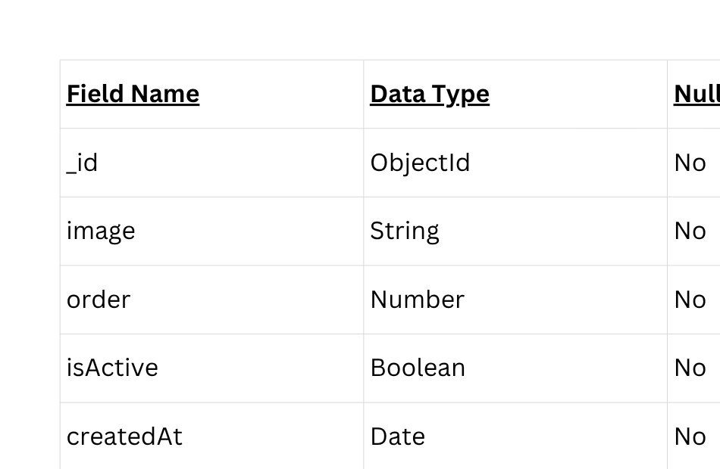
CMS BANNER

Slide 12
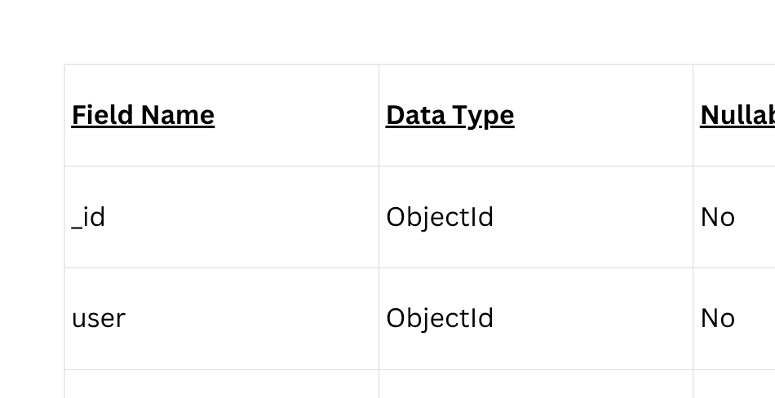
CART

Slide 13
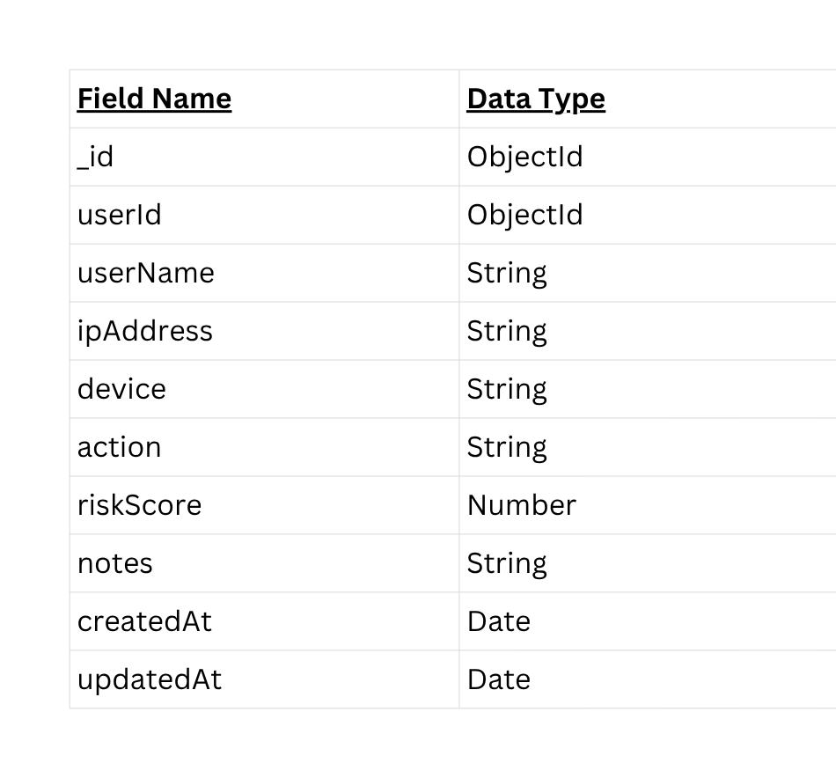
FroudsLog

Slide 14
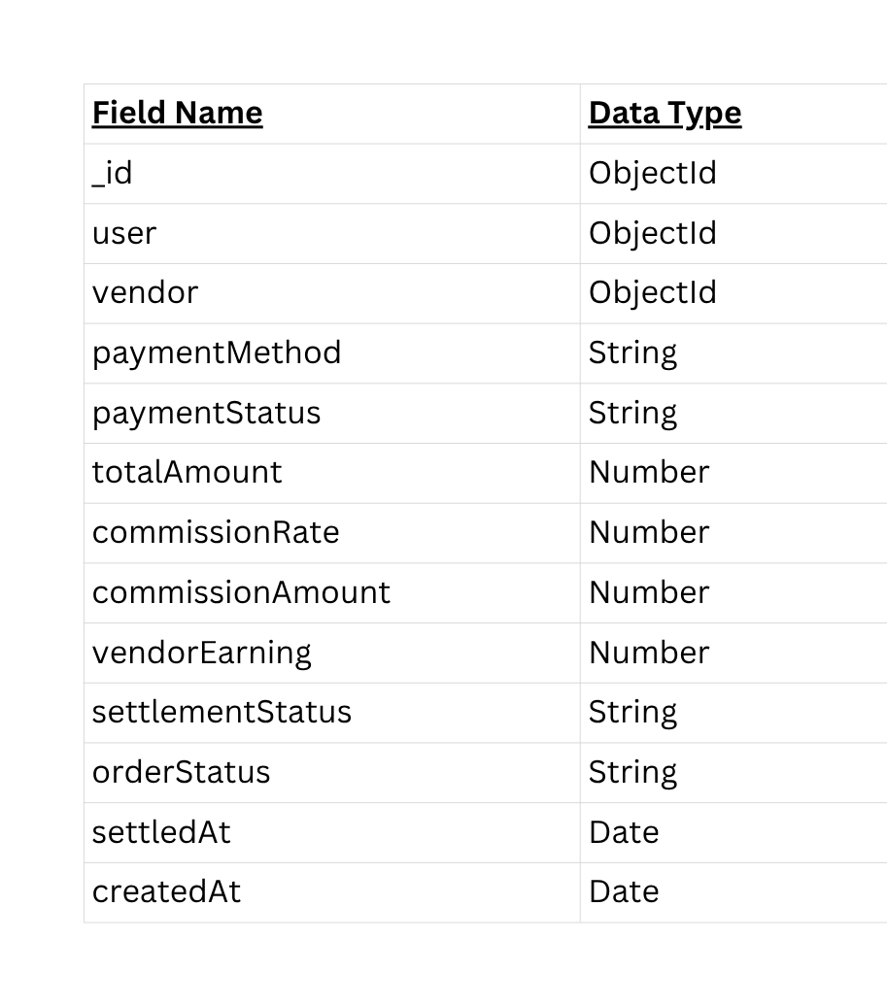
Orders

Slide 15
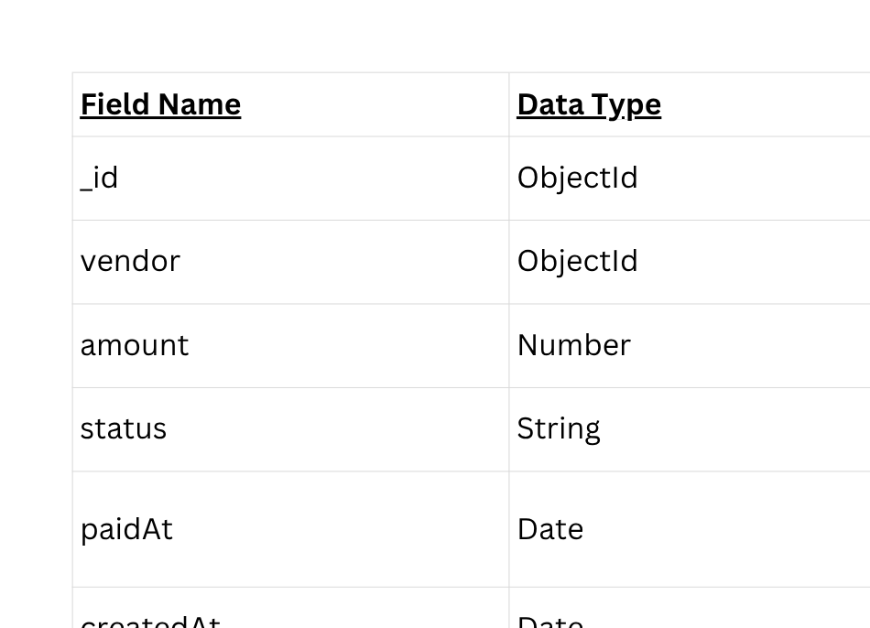
Payouts

Slide 16
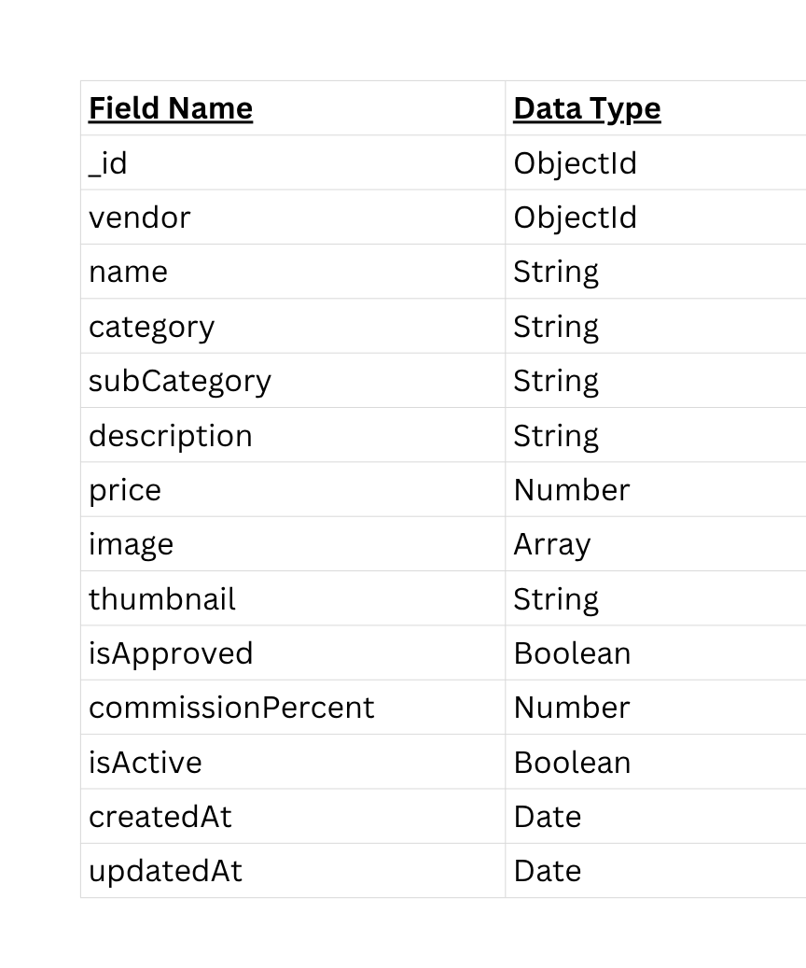
Product

Slide 17
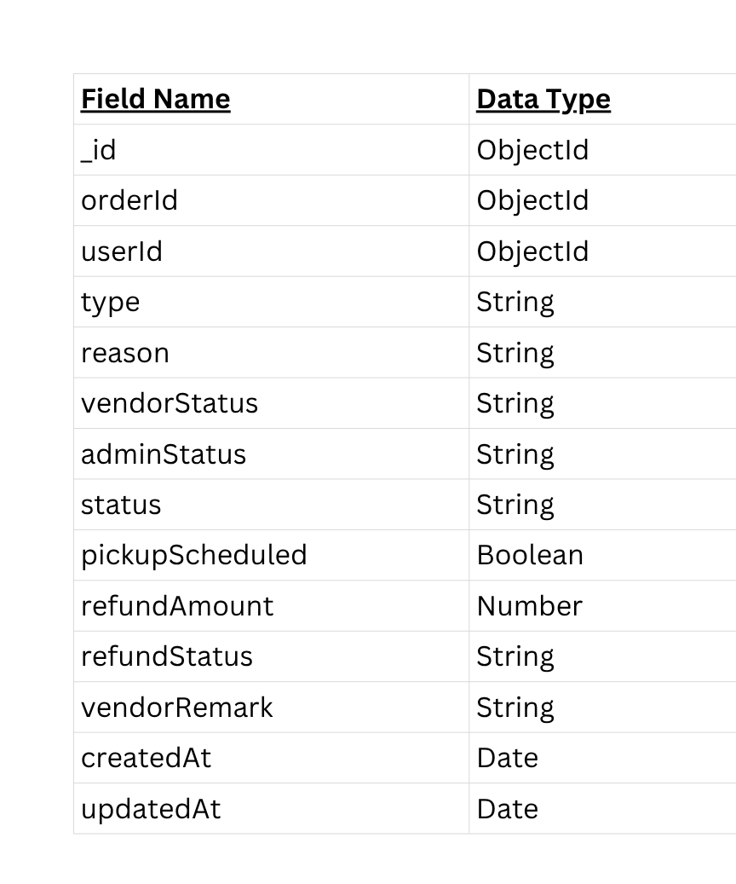
Returns

Slide 18
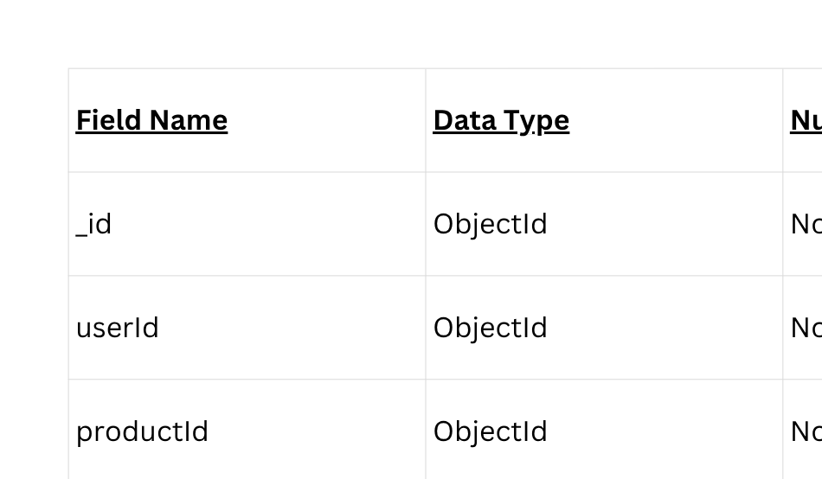
UserActivity

Slide 19
Form Designing

Slide 21


Conclusion
Wardrobe X successfully delivers a comprehensive and scalable online clothing shopping platform that integrates user-friendly design with advanced backend functionalities. The system supports multi-user roles including customers, vendors, and administrators, ensuring efficient product management, order processing, and secure transactions.
With features like AI-based recommendations, return and exchange management, fraud detection, and vendor settlements, the project reflects real-world e-commerce architecture. Overall, Wardrobe X provides a reliable, efficient, and modern solution that enhances user experience while supporting business growth.

Slide 22


References / Bibliography
Official documentation of React.js
Node.js documentation
Express.js documentation
MongoDB documentation
JWT Authentication
Razorpay / Stripe API documentation for payment integration
MDN Web Docs for HTML, CSS, and JavaScript

Slide 23





Borcelle
Thank You
Very Much
Do you have any questions?
123-456-7890
We are excited to discuss how Borcelle can revolutionize your shopping experience and help your business grow.
reallygreatsite.com
wardrobe@gmail.com

